Slide 1


Sean F. Cahill
March, 2022

Slide 2

Outline
Executive Summary
Introduction
Methodology
Results
Conclusion
Appendix

Slide 3
Executive Summary
Summary of methodologies:
For this project, we used web scraping to extract open-source data regarding SpaceX launch success. We then took various steps to clean and wrangle the data into its most effective format. Once that was completed, we performed various exploratory data analyses procedures to help identify relevant information. Once the data was prepared, we were able to feed it into various machine learning models to attempt to predict the success and failure rates of SpaceX launches.
Summary of all results:
This project was able to create a Decision Tree Classifier model that recorded 94% accuracy on available data. A series of SQL and graphing queries provided us with an excellent framework to support our findings, and an interactive map with launch integrated launch information allows the user to explore the data on their own.

Slide 4
Introduction
Project background and context:
Our goal is to predict if the Falcon 9 first stage will land successfully. SpaceX advertises Falcon 9 rocket launches on its website with a cost of 62 million dollars; other providers cost upward of 165 million dollars each. Much of the savings is because SpaceX can reuse the first stage; if we can determine if the first stage will land, we can determine the cost of a launch. This information can be used if a competing company wants to bid against SpaceX for a rocket launch.
Problems you want to answer:
What data is available?
What characteristics affect the successful landing of a rocket?
Can we predict if a launch will be successful or not?
How accurate are our predictions?

Slide 5


Slide 6
Methodology
Data collection methodology
Request to the SpaceX API
Data scraping (Wikipedia)
Perform data wrangling
Identify missing, numeric, and categorical values
Create a landing outcome label
Perform exploratory data analysis (EDA) using visualization and SQL
Perform interactive visual analytics using Folium and Plotly Dash
Perform predictive analysis using machine learning models

Slide 7
Data Collection
HTTP request through the SpaceXdata.com API
Import libraries
Define functions to assist loading the data
Call API
Request and parse data using GET request
Convert JSON files to Pandas DataFrame
Deal with missing values
Export to CSV
Webscrape Space X launch data from Wikipedia
Import libraries
Define functions to assist loading the data
Define HTTP GET method to request HTML page
Create BeautifulSoup object for HTML response
Collect relevant column names from header table
Select table with launch information
Parse table and create Pandas DataFrame
Export to CSV

Slide 8
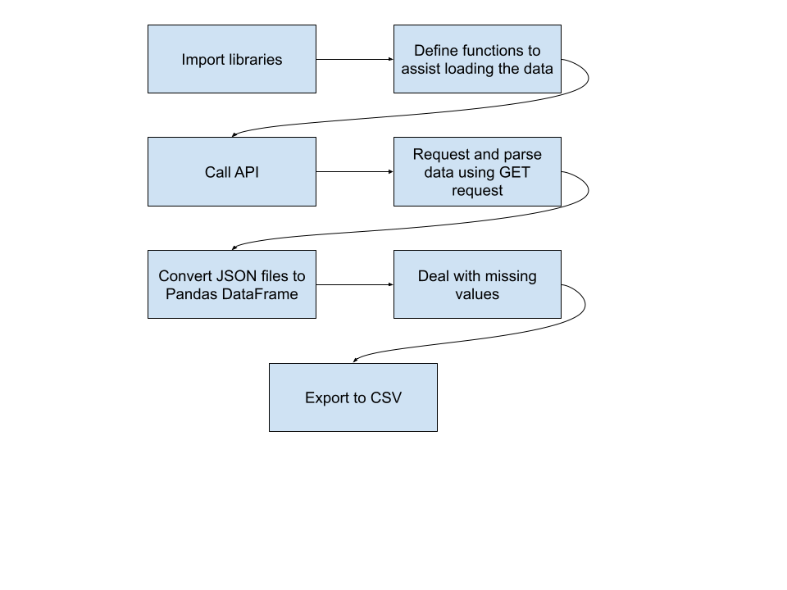
Data Collection – SpaceX API
Present your data collection with SpaceX REST calls using key phrases and flowcharts
Add the GitHub URL of the completed SpaceX API calls notebook (must include completed code cell and outcome cell), as an external reference and peer-review purpose
URL: Week One: Data Collection API
Notes:
https://github.com/cahills9/Applied-Data-Science-Capstone/blob/b7a221690da6aae5a11e1e35f3cb6b51ed1ee993/Week%20One:%20Data%20Collection%20API.ipynb

Slide 9
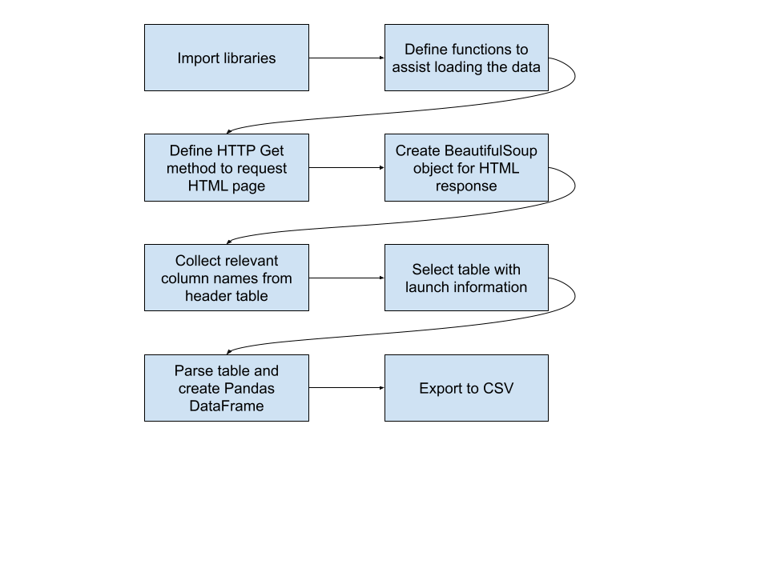
Data Collection - Scraping
Present your data collection with SpaceX REST calls using key phrases and flowcharts
Add the GitHub URL of the completed SpaceX API calls notebook (must include completed code cell and outcome cell), as an external reference and peer-review purpose
URL: Week One: Data Collection with Web Scraping
Notes:
https://github.com/cahills9/Applied-Data-Science-Capstone/blob/main/Week%20One:%20Data%20Collection%20with%20Web%20Scraping.ipynb

Slide 10
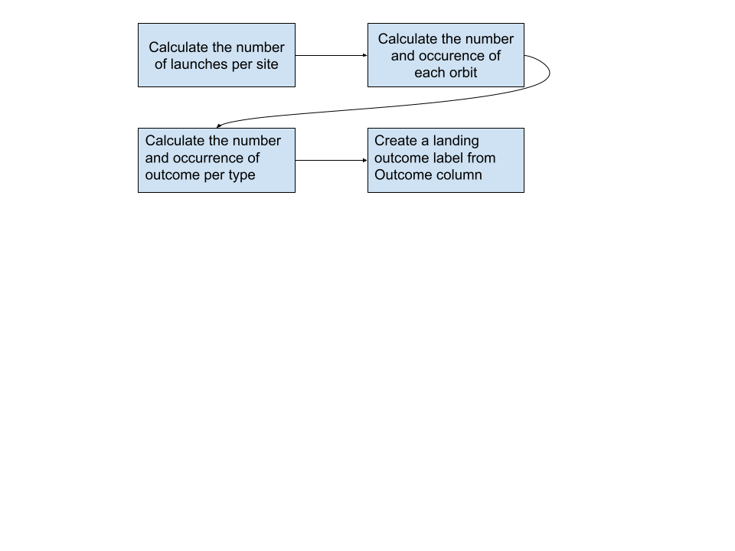
Data Wrangling
Present your data collection with SpaceX REST calls using key phrases and flowcharts
Add the GitHub URL of the completed SpaceX API calls notebook (must include completed code cell and outcome cell), as an external reference and peer-review purpose
URL: Week One: EDA
Notes:
https://github.com/cahills9/Applied-Data-Science-Capstone/blob/main/Week%20One:%20EDA.ipynb

Slide 11
EDA with Data Visualization
Summarize what charts were plotted and why you used those charts
Add the GitHub URL of your completed EDA with data visualization notebook, as an external reference and peer-review purpose
URL: Week Two: EDA with Data Visualization
Notes:
https://github.com/cahills9/Applied-Data-Science-Capstone/blob/main/Week%20Two:%20EDA%20with%20Data%20Visualization.ipynb

Slide 12
EDA with SQL
Using bullet point format, summarize the SQL queries you performed
Add the GitHub URL of your completed EDA with SQL notebook, as an external reference and peer-review purpose
URL: Week Two: EDA with SQL
Notes:
https://github.com/cahills9/Applied-Data-Science-Capstone/blob/main/Week%20Two:%20EDA%20with%20SQL.ipynb

Slide 13
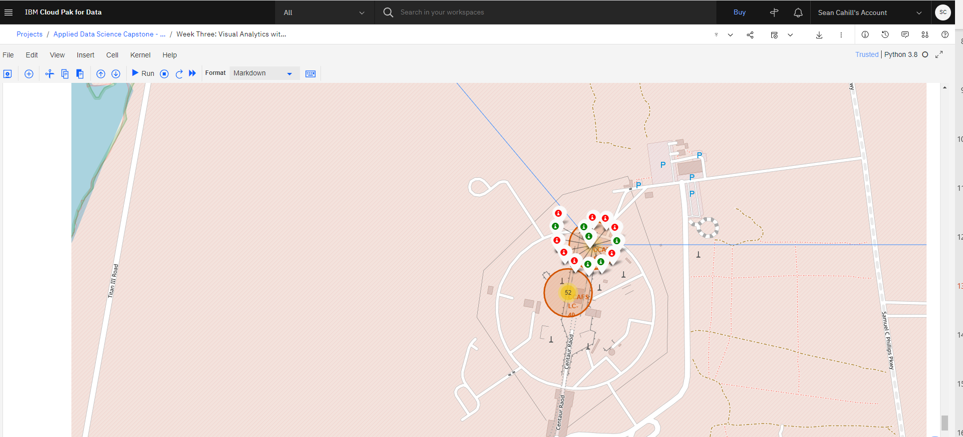
Build an Interactive Map with Folium
Circles/Markers: Launch Sites
Lines/Symbols: Designate and distance between locations
Add the GitHub URL of your completed interactive map with Folium map, as an external reference and peer-review purpose
URL: Week Three: Visual Analytics with Folium
Notes:
https://github.com/cahills9/Applied-Data-Science-Capstone/blob/main/Week%20Three:%20Visual%20Analytics%20with%20Folium.ipynb

Slide 14
Load data
Create NumPy array
Standardize data (Standard Scaler)
Split into training and test sets
Create machine learning object
Fit the object to find best parameters (GridSearchCV)
Calculate accuracy on test data
Create confusion matrix for comparison between models
Logistic Regression
Support Vector Machine
Decision Tree Classifier
K – Nearest Neighbor
Predictive Analysis (Classification)
Summarize how you built, evaluated, improved, and found the best performing classification model
You need present your model development process using key phrases and flowchart
Add the GitHub URL of your completed predictive analysis lab, as an external reference and peer-review purpose
URL: Week Four: Machine Learning Predictions
Notes:
https://github.com/cahills9/Applied-Data-Science-Capstone/blob/main/Week%20Four:%20Machine%20Learning%20Prediction.ipynb

Slide 15
Results
Exploratory data analysis results
Calculated number of launches per site
Calculate number and occurrence of each orbit
Calculate the number and occurrence of mission outcome per orbit type
Interactive analytics demo in screenshots
Plot flight characteristics (payload, flight number, launch site) vs. success rate
Predictive analysis results
Decision tree classifier performed best
Accuracy rating of 94.4%

Slide 16


Slide 17
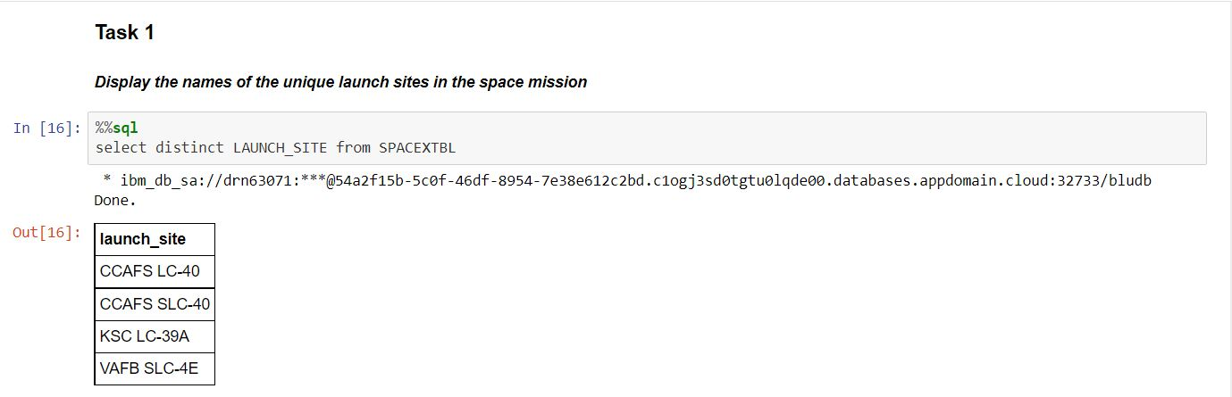
All Launch Site Names
Display the names of the unique launch sites in the space mission

Slide 18
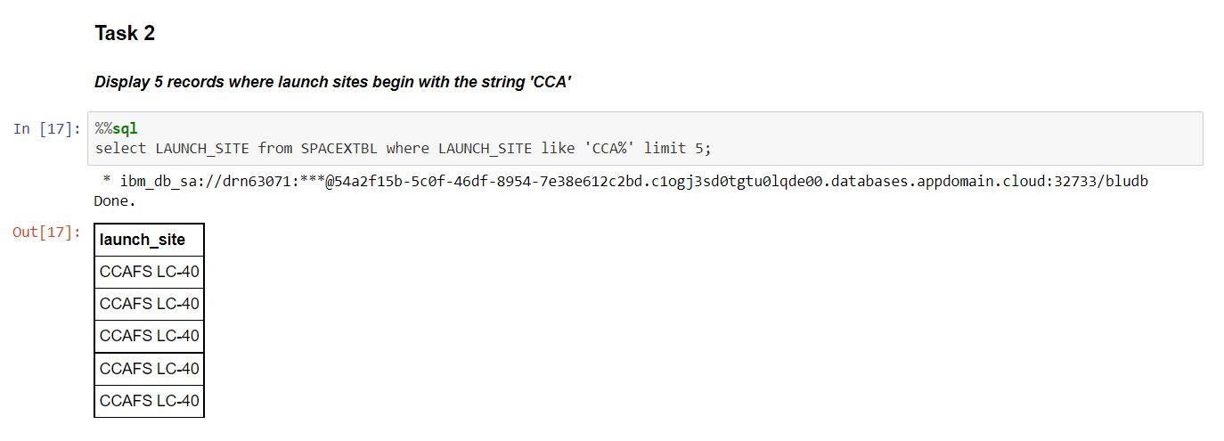
Launch Site Names Begin with 'CCA'
Find 5 records where launch sites begin with `CCA`

Slide 19
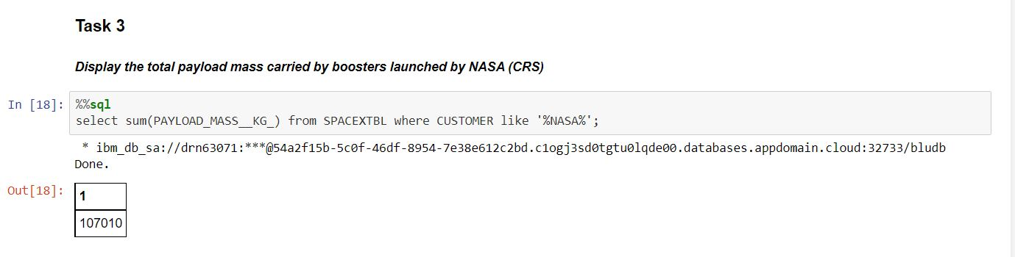
Total Payload Mass
Calculate the total payload carried by boosters from NASA

Slide 20
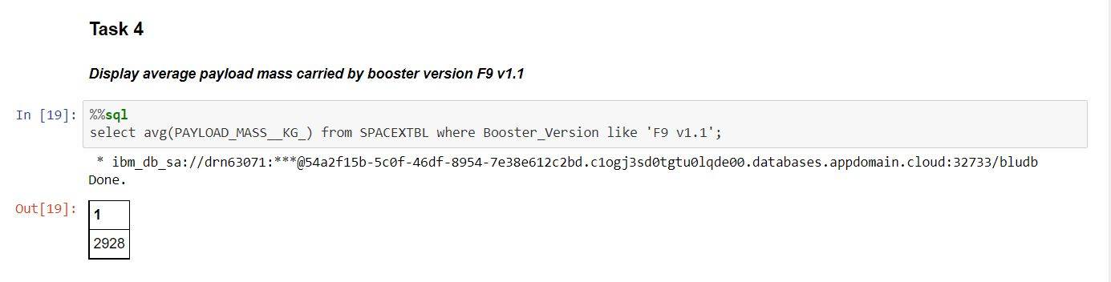
Average Payload Mass by F9 v1.1
Calculate the average payload mass carried by booster version F9 v1.1

Slide 21
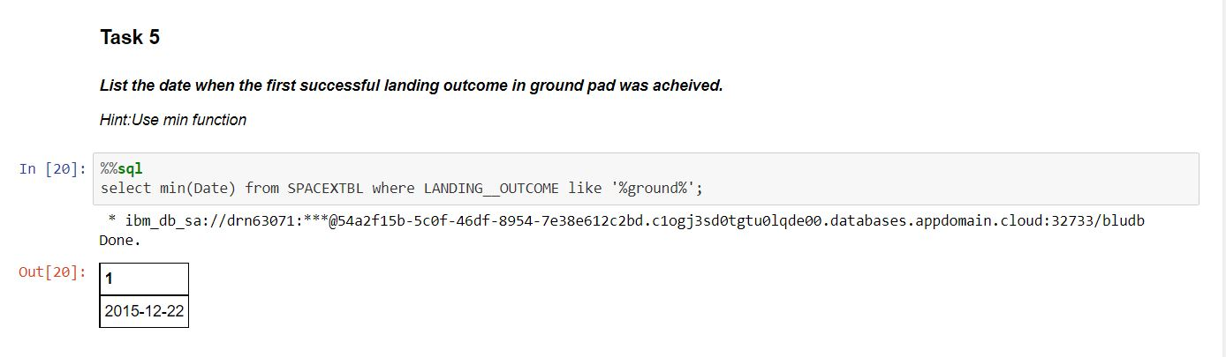
First Successful Ground Landing Date
Find the dates of the first successful landing outcome on ground pad

Slide 22
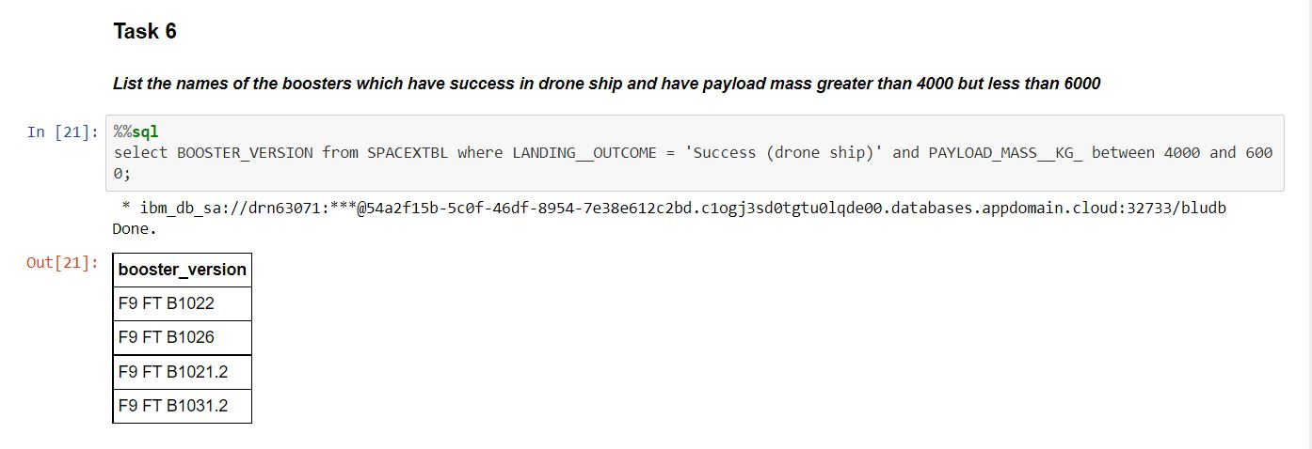
Successful Drone Ship Landing with Payload between 4000 and 6000
List the names of boosters which have successfully landed on drone ship and had payload mass greater than 4000 but less than 6000

Slide 23
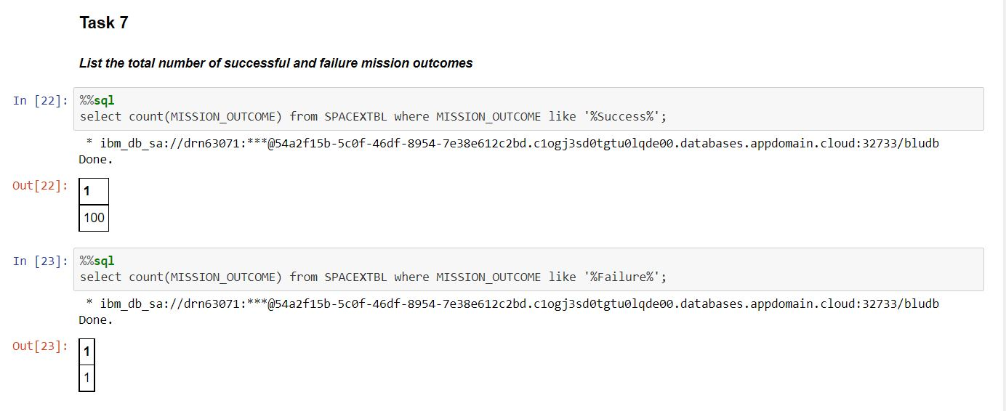
Total Number of Successful and Failure Mission Outcomes
Calculate the total number of successful and failure mission outcomes

Slide 24
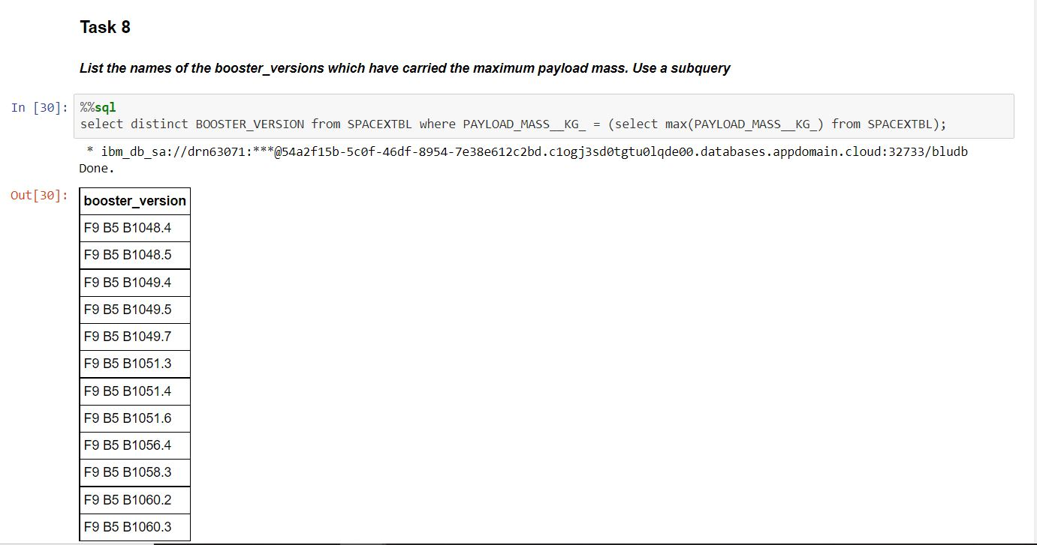
Boosters Carried Maximum Payload
List the names of the booster which have carried the maximum payload mass

Slide 25
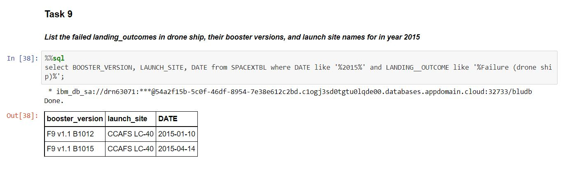
2015 Launch Records
List the failed landing outcomes in drone ship, their booster versions, and launch site names for in year 2015

Slide 26
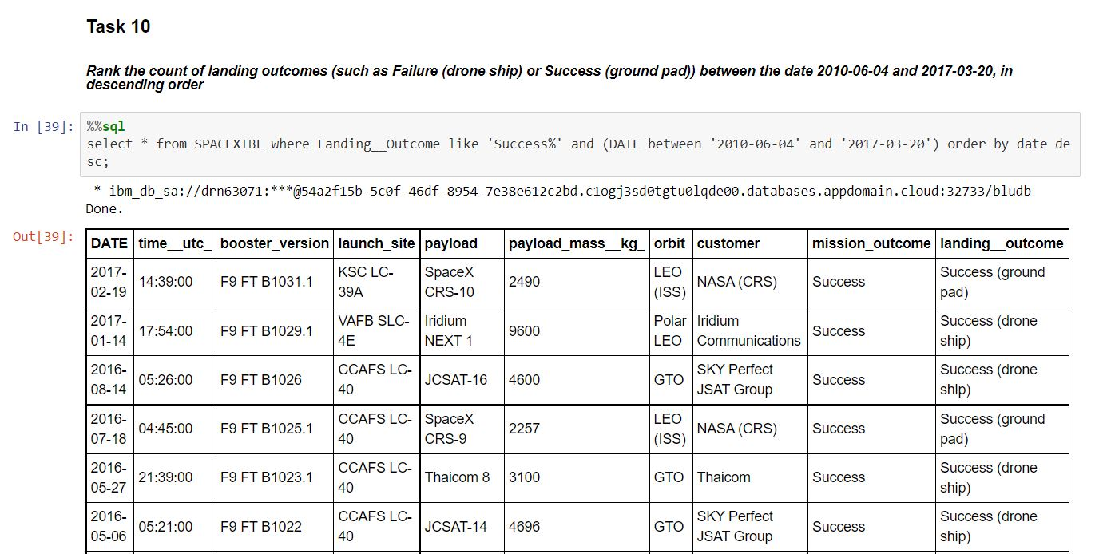
Rank Landing Outcomes Between 2010-06-04 and 2017-03-20
Rank the count of landing outcomes (such as Failure (drone ship) or Success (ground pad)) between the date 2010-06-04 and 2017-03-20, in descending order

Slide 27


Slide 28
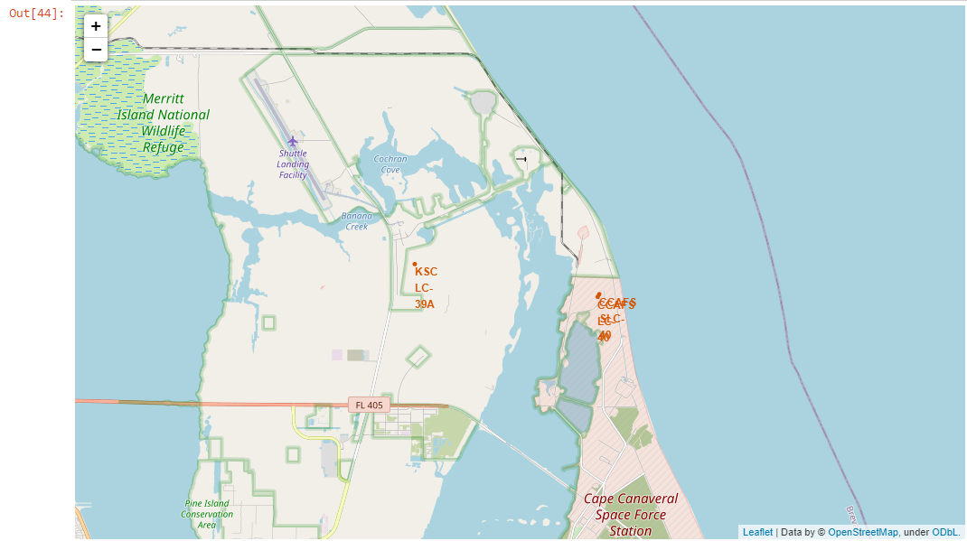
Folium Map – Launch Locations

Slide 29
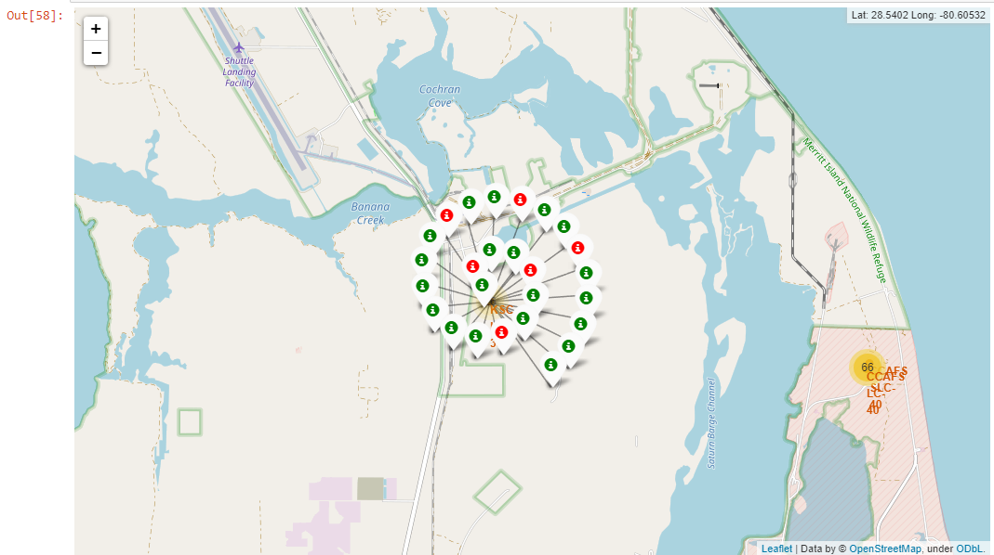
Folium Map – Success and Failures

Slide 30
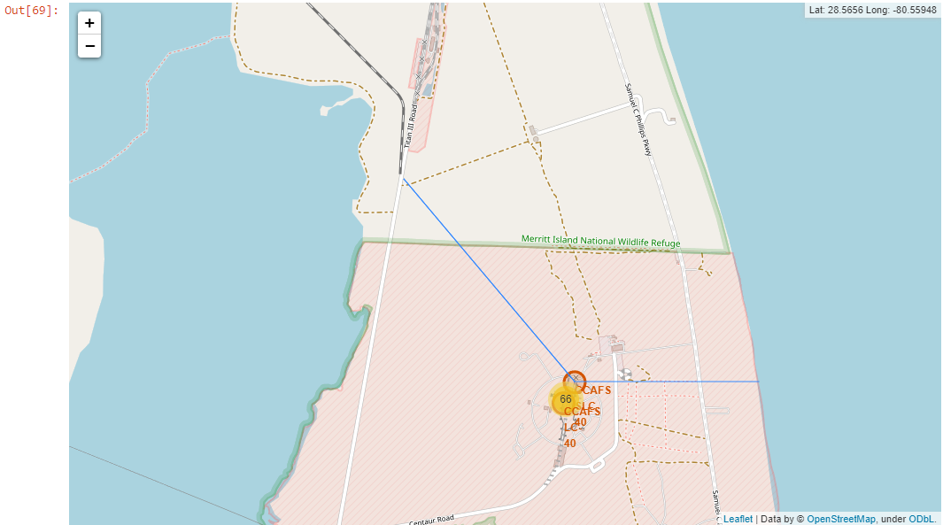
Folium Map – Distance to Coast and Railway

Slide 31


Slide 32
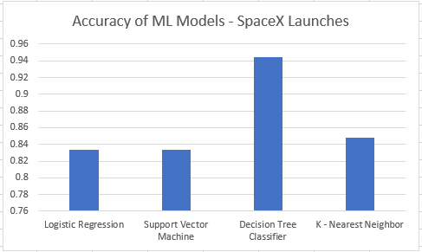
Classification Accuracy

Slide 33
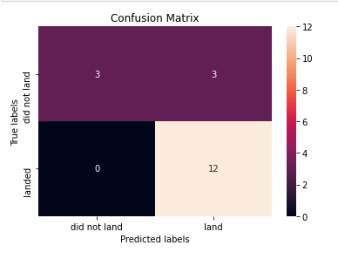
Confusion Matrix – Decision Tree Classifier
Vertical is observed data
Horizontal is predicted events
100% landing predictions acc.
50% did not land prediction acc.
Best performing model

Slide 34
Conclusions
We can successfully use open-source data to make predictions regarding
the success rate of SpaceX launches.
Top characteristics affecting the success of a launch are payload mass and orbit types.
Using accuracy tools built into our models we can quantify the accuracy of each model
with the data we have available.
Using machine learning models we can make strong predictions about the likelihood of
a flight’s success or failure rate.

Slide 35


